Slide 1
Week 4 Lecture 1
Models as aids to problem solving

Slide 2
In the last lecture
  An introduction to flowcharts
  An introduction to pseudo-code
  These are models of the solution to a problem
In this lecture
  Other models to help problem solving
  Visualisations are useful for problem solving

Slide 3
Problem 1
One morning at 8am I set off for a friends house a long distance away. There are traffic delays and I stop off a couple of times for a break. I arrive a 6pm and stay overnight. The next morning I leave at 8am and head for home. I encounter more traffic delays and take just one break. I arrive home at 6pm. Is there some point on the road that I pass at exactly the same time on the outward and return journeys? (Vickers, 2008)

Slide 4
Problem 1
What if starting and finishing times differ?

Slide 5
Lessons learned
Visualisations, Physical models and mathematical models can help solve problems
Problems can be simplified into similar problems with the same solution

Slide 6
Problem 2
Take a chessboard (64 squares) and 32 dominoes. Each domino fits over two (non-diagonally) adjacent squares on the chessboard. Now cut off two opposite corners of the chessboard and remove one domino. Now you have 62 squares and 31 dominoes. Can you still cover the chessboard? (Vickers, 2008)

Slide 7
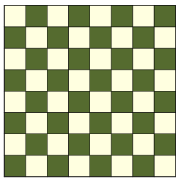
Chessboard – Problem 2

Slide 8
Lessons learned
Abstraction: there are twice the number of squares as dominoes in each case
Have we left out any important details?
  Any incorrect assumptions?

Slide 9
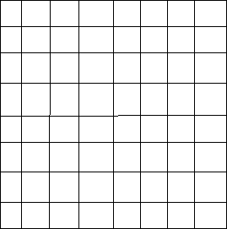
Chessboard
Suppose you are making a chessboard but for some reason you have decided to paint each square in a random order. Without continually checking ‘white, black, white, black’ from the top left corner or looking at an existing chessboard how else could you determine whether a given square should be black or white? (Vickers, 2008)

Slide 10
Problem 3
There is a large square room whose walls are 24 feet long. The ceiling is 8 feet high. On the floor in a corner is a bowl of sugar. In the opposite corner by the ceiling is an ant. What is the shortest path the ant can take to get to the sugar? (The ant can’t fly) (Vickers, 2008)
  Can you break this problem into two simpler problems?

Slide 11
Problem 3
Suppose the ant is replaced by a fly that can fly! What is the shortest path now?
Does this type of problem have any real applications?

Slide 12
Problem 4
The hard drive in Nick’s computer has twice the capacity of Alf’s. Between them their computers have 240 gigabytes of hard-drive storage. What is the capacity of each hard-drive? (Vickers, 2008)

Slide 13
References
P. Vickers, “How to Think Like a Programmer: Problem Solving for the Bewildered”, 2008, Cengage Learning

Slide 14
Summary
Different types of models can be used to assist problem solving
  Visualisations
  Physical models
  Mathematical models using algebra
Different models are suited to different problems

